Slide 1

Proton Pump Inhibitors
Christopher Lacey,
India Mckenzie
Preceptors:
Nikki McBurrows, Elizabeth Santa

Slide 2
objectives
To recognize, name, recall, and arrange the proton pump inhibitors dispensed within the VA pharmacy.
To answer questions pertaining to:
Indication for use
Dosage
Duration of use
Side effects / interactions
Weaning off proton pump inhibitors

Slide 3
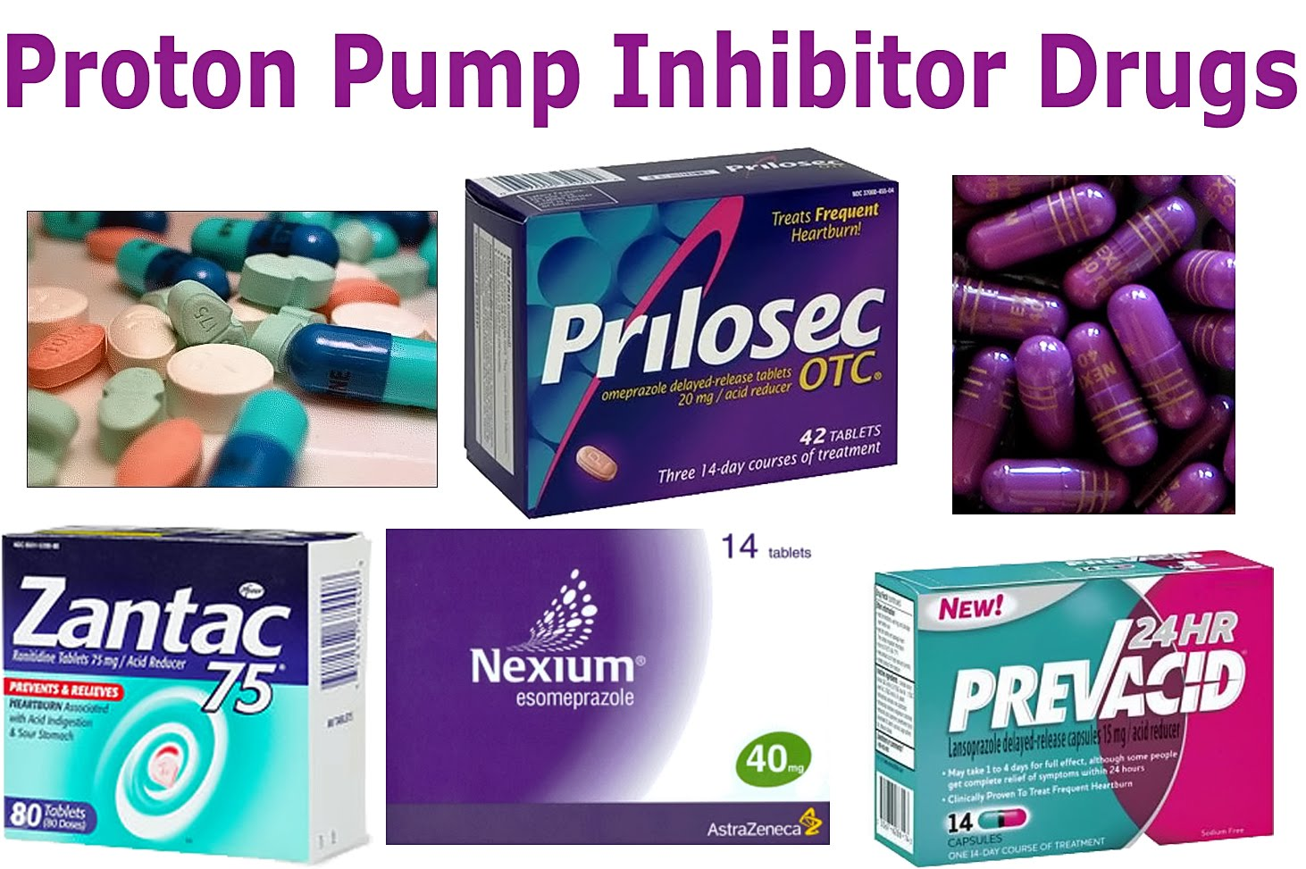
PREVIEW
Introduction & Problem Statement
Controversy of PPI Rx use
Indications
FDA labeled indications
Off-label indications
Side Effects / Adverse Effects
Minor side effects
Major side effects
PPI Weaning
Step-down studies

Slide 4
Introduction & Problem Statement
Numerous of Indications for PPI’s
Spectrum of severity for the different diseases managed by PPI therapy. Ex. GERD
Duration of therapy is dubious
Education is key

Slide 5
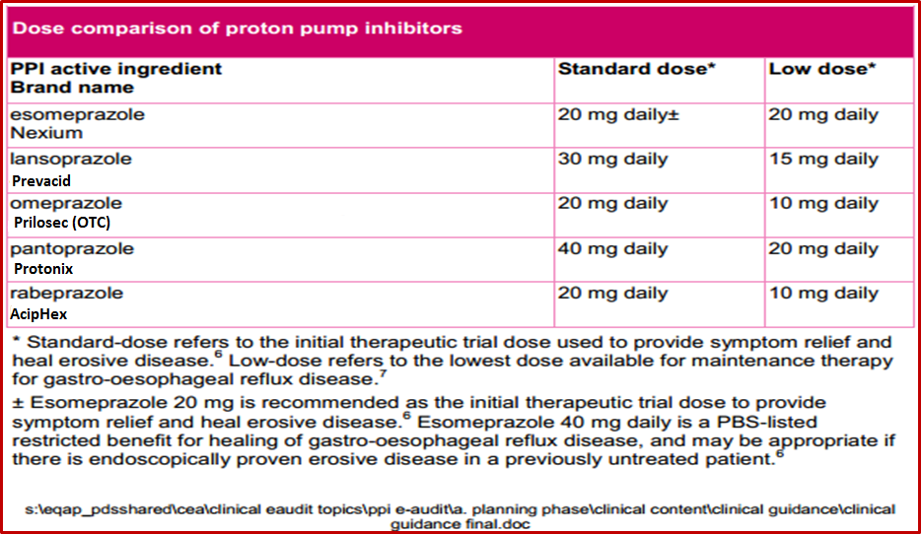
Drug class overview
Notes:
Bioavailability
At equivalent doses, all PPIs are clinically equivalent in most patients.

Slide 6
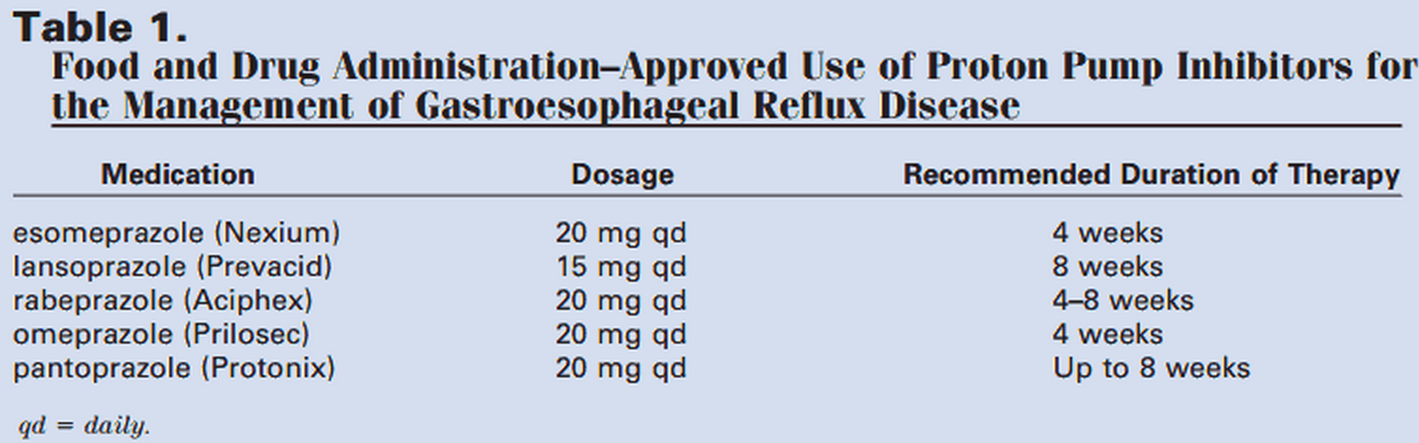
Overview of duration of therapy for GERD
Notes:
https://docs.google.com/file/d/0BxdPy_udLBt2ZndjSGZvZkNEdjg/edit

Slide 7
Pantoprazole
Indication | Dose | Duration | Comments
Non-erosive GERD and Barrett’s esophagus (treatment is the same as GERD treatment) | For symptomatic treatment of non-erosive GERD: Oral Initially 20 mg PO once daily 30—60 minutes before the first meal of the day. Consider 20 mg twice a day for patients with partial response to once daily dosing.⁶ | Treatment lasts up to 4 weeks for nonerosive GERD.⁴ | Renal: No dosage adjustment Hepatic: No dose adjustment Intermittent hemodialysis: No dosage adjustment is necessary. Pantoprazole is not removed by hemodialysis.
Erosive GERD (erosive esophagitis) & Barrett’s esophagus | Initially 40 mg PO once daily 30 minutes before the first meal of the day. Can increase to 80 mg/day (up to 120 mg/day)⁹ IV: 40 mg Q24H for 7-10 days. Us as an alternative to oral therapy for short term treatment Max dose: 40 mg/day PO or IV for most GERD indications. Up to 120 mg/day PO for severe esophagitis or GERD | Treatment lasts up to 8 weeks for erosive GERD. | ACG recommends that, in patients with Barrett’s esophagus, GERD be managed in the same manner as in patients with GERD who do not have Barrett’s esophagus: Antireflux therapy (medical or surgical) should not be prescribed beyond that needed for healing signs and symptoms of reflux esophagitis.³ IV administration does not raise gastric pH levels sufficiently to treat life-threatening upper GI bleeds. Switch to oral therapy when feasible.¹⁰

Slide 8
Pantoprazole
Indication | Dose | Duration | Comments
Eosinophilic Esophagitis (EoE) | 20-40 MG PO twice daily 30-60 minutes before meals Max Dose: 30 mg/day PO for most indications | Treat for up to 8 weeks and continue until the time of the follow-up endoscopy and biopsy. | According to guidelines, a PPI trial is central to the differential diagnosis of EoE. If eosinophilia and symptoms persist on repeat endoscopy and biopsy following a PPI trial, then EoE can be formally diagnosed. If symptoms and eosinophilia resolve, then PPI-REE is diagnosed.¹⁷
prophylaxis of nosocomial upper gastro-intestinal tract bleeding. | 80 mg IV bolus infusion over 30 minutes, followed by 8 mg/h. Continuous infusion for 72 hours is recommended after successful endoscopic hemostasis in patients with active bleeding, a non-bleeding visible vessel, or an adherent clot. | Once daily therapy is continued in patients with an underlying etiology for PPI use. otherwise discontinue PPI before discharge. | Patients with an underlying etiology for which a PPI may be beneficial (e.g., peptic ulcers, erosions) should be discharged with a prescription for standard, once daily, oral PPI therapy; otherwise, discontinue the PPI before discharge.²³

Slide 9
Pantoprazole
Indication | Dose | Duration | Comments
Peptic Ulcer Disease, Healing of Duodenal Ulcer, H. pylori eradication | 40 mg PO once daily, until healing and symptom relief has occurred (ie. 2-8 weeks).⁵ | American College of Gastroenterology (ACG) recommends 10-14 days of triple-drug regimen containing a PPI, clarithromycin, and either amoxicillin or metronidazole.⁷ Gastric ulcers generally take longer than duodenal ulcers and may require 4-8 weeks of therapy.⁸ | Safe and effective use of pantoprazole for long-term maintenance therapy (ie. > 16 weeks) of gastric ulcer disease has not been established.

Slide 10
Pantoprazole
Indication | Dose | Duration | Comments
Hypersecretion conditions including Zollinger-Ellison Syndrome, Systemic Mastocytosis, and multiple Endocrine Adenoma Syndrome | Initially 40 mg PO twice daily. Max Dose: 240 mg/day. IV: Initially 80 mg Q12H. May require dosage increase to 80 mg IV Q8H. TTD 160mg up to Max dose of 240 mg controls acid for 7 days.¹ | Some patients continuously treated for > 2 years on Pantoprazole. | Safe and effective IV pantoprazole beyond 10 days not established, switch to PO when feasible.
Erosive Reflux Oesophagitis | 40 mg PO once Daily 30 minutes before the first meal of the day IV: 40 mg IV infused once daily for 7-10 days. | Once daily for up to 8 weeks (short-term treatment). For adults who have not healed after 8 weeks of treatment, an additional 8 weeks of therapy may be considered. Therapy duration during clinical trials ≤ 12 months were effective in reducing episodes of heartburn.² | Higher oral doses of 80 mg/day (up to 120 mg/day) have been administered safely to patients with esophagitis in published clinical trials.¹

Slide 11
Pantoprazole
Indication | Dose | Duration
Short-term treatment of frequent dyspepsia or pyrosis (heartburn) occurring ≥ twice / week | 20-40 mg PO once daily for up to 14 days. | Full relief may take 1-4 days.
NSAID-induced ulcer prophylaxis | 40 mg PO once daily | Healing rates can be obtained in 4 to 12 weeks.²⁷
Stress gastritis prophylaxis in critically ill patients | Oral or Intravenous: 40 mg daily IV or PO | Optimum duration is unclear, provide therapy while risk factors are present, the patient is in a critical care unit, or for a least 1 week after onset of critical illness.²⁸

Slide 12
Lansoprazole
Indication | Dose | Duration | Comments
Non-erosive GERD and Barrett’s esophagus (treatment is the same as GERD treatment) | Initially 15 mg PO once daily QAM 30-60 minutes before meals. Can increase to 15 mg PO twice daily for patients nonresponsive to once daily treatment. | Duration of therapy should be up to 8 weeks | Renal: No dosage adjustment Hepatic: Consider dosage reduction in patients with severe hepatic disease Elderly: 30 mg/day PO for most indications; 90 mg/day PO for eradication of H. pylori; up to 180 mg/day PO for Z-E syndrome. Intermittent hemodialysis Lansoprazole is not removed by hemodialysis.
Erosive GERD (erosive esophagitis) and Barrett’s esophagus | 30 mg PO QAM 30-60 minutes before the first meal of the day. IV: 30 mg IV once daily infused over 30 minutes for up to 7 days. Max dose: 30 mg/day PO for most indications | Once daily for up to 8 weeks (short-term treatment.) For adults who have not healed after 8 weeks of treatment, an additional 8 weeks of therapy may be considered. Therapy duration during clinical trials ≤ 12 months were effective in reducing episodes of heartburn.¹¹ | Switch to oral therapy when feasible. Oral and IV lansoprazole equally suppress acid production.¹² Oral and IV lansoprazole equally suppress acid production.

Slide 13
Lansoprazole
Indication | Dose | Duration | Comments
Eosinophilic Esophagitis | 20-40 mg PO twice daily 30-60 minutes before meals Max Dose: (Adults/Elderly) 30 mg/day PO for most indications | Treat for up to 8 weeks and continue until the time of the follow-up endoscopy and biopsy. | A PPI trial is central to the differential diagnosis of EoE. If eosinophilia and symptoms persist on repeat endoscopy and biopsy following a PPI trial, then EoE can be formally diagnosed. If symptoms and eosinophilia resolve, then PPI-REE is diagnosed.¹⁷
Hypersecretion conditions including Zollinger-Ellison Syndrome, Systemic Mastocytosis, and multiple Endocrine Adenoma Syndrome | Initially 60 mg PO once daily QAM 30 minutes before meals. Doses up to 90 mg twice daily have been used. If dosage > 120 mg/day, give in divided doses. | Some patients continuously treated for > 4 years on Lansoprazole. | .

Slide 14
Lansoprazole
Indication | Dose | Duration | Comments
Erosive Reflux Oesophagitis | Adults: Initially 60 mg PO once daily QAM 30 minutes before meals. Doses up to 90 mg twice daily have been used. If dosage > 120 mg/day, give in divided doses. | Once daily for up to 8 weeks (short-term treatment.) For adults who have not healed after 8 weeks of treatment, an additional 8 weeks of therapy may be considered. Therapy duration during clinical trials ≤ 12 months were effective in reducing episodes of heartburn.² | Doses should be clinically individually dosed Higher oral doses of 80 mg/day (up to 120 mg/day) have been administered safely to patients with esophagitis in published clinical trials.¹
Short-term treatment of frequent dyspepsia or pyrosis (heartburn) occurring ≥ twice / week | 15 mg PO once daily for up to 14 days. | Full relief may take 1-4 days. Reassess if frequent heartburn returns after a 14 day course of treatment. | Do not take for more than 14 days or more often than every 4 months unless otherwise advised to do so by a physician.

Slide 15
Lansoprazole
Indication | Dose | Duration
Treatment of active duodenal ulcer or active benign gastric ulcer | 15 mg PO once daily in the AM at least 30 minutes before a meal. | Up to 4 weeks. For maintenance remission, 15 mg PO once daily in the morning at least 30 minutes before a meal may be continued.
Peptic Ulcer Disease, Healing of Duodenal Ulcer, H. pylori eradication | 30 mg PO twice daily with amoxicillin (1gm twice daily) and clarithromycin (500 mg twice daily), and metronidazole (500 mg twice daily), all administered PO for 10-14 days.¹¹ | American College of Gastroenterology recommends 10-14 days of triple-drug regimen containing a PPI, clarithromycin, and either amoxicillin or metronidazole.⁷ Gastric ulcers take longer than duodenal ulcers (4-8 weeks of therapy.)⁸
NSAID-induced ulcer prophylaxis or healing | Treat an active NSAID-associated gastric ulcer in patients who continue NSAID use: 30 mg PO once daily in the morning at least 30 minutes before a meal Reduce the risk of NSAID-associated ulcers in patients with a prior documented gastric ulcer, who require NSAID therapy: 15 mg PO once daily in the morning at least 30 minutes before a meal | Treat for 8 weeks for active NSAID-associated gastric ulcer in patients who continue NSAID use.¹¹ Treat NSAID-associated ulcers in patients with a prior documented gastric ulcer, who require NSAID therapy for 12 weeks.

Slide 16
Lansoprazole
Indication | Dose | Duration | Comments
For stress gastritis prophylaxis in critically-ill patients | 30 mg lansoprazole once daily via nasogastric tube Lansoprazole oral disintegrating tablet: 30 mg lansoprazole once daily via nasogastric tube. Mix a 30 mg orally disintegrating tablet (LODT) in 10 ml of water, administer via nasogastric tube | Based on the current literature review, it is unclear when prophylaxis should be discontinued. Most studies recommend the continuation of stress ulcer prophylaxis throughout the duration of critical illness or intensive care unit stay.^{[35][36]} | May open capsule and pour one-quarter of the granules into a nasogastric feeding syringe with the plunger removed. Slowly add water through the plunger end and push the water and granules through the tube by depressing the plunger. Repeat the process until all the granules are administered; flush tube with 15 ml of water to administer any residual granule.²⁹ Mix a 30 mg orally disintegrating tablet (LODT) in 10 ml of water, administer via nasogastric tube; flush tube with 10 ml of sterile water and clamp for 60 minute.³⁰

Slide 17
Omeprazole
Indication | Dose | Duration | Comments
Non-erosive GERD and Barrett’s esophagus (treatment is the same as GERD treatment) | For symptomatic treatment of non-erosive GERD: 20 mg 60 minutes before the first meal of the day or 20 mg twice a day for patients nonresponsive to once a day therapy. | Treatment lasts up to 4 weeks for non-erosive GERD | Renal: No dosage adjustment Hepatic: Consider dosage reduction in patients with severe hepatic disease Intermittent hemodialysis No dose adjustments needed
Erosive GERD (erosive esophagitis) and Barrett’s esophagus | For the treatment of erosive GERD: 20 mg 60 minutes before the first meal of the day Max Dose: 40 mg / day PO for most indications. | 4-8 weeks but may continue for an additional 4 weeks for patients unresponsive to therapy

Slide 18
Omeprazole
Indication | Dose | Duration | Comments
Eosinophilic Esophagitis | 20-40 mg PO twice daily 30-60 minutes before meals Max Dose: 40 mg/day PO for most indications | Treat for up to 8 weeks and continue until the time of the follow-up endoscopy and biopsy. | PPI trial is central to the diagnosis of EoE. If eosinophilia and symptoms persist on repeat endoscopy following a PPI trial, then EoE can be formally diagnosed. If symptoms and eosinophilia resolve, then PPI-REE is diagnosed.¹⁷

Slide 19
Omeprazole
Indication | Dose | Duration
H. pylori eradication | 20 mg PO twice daily with amoxicillin (1gm twice daily) & clarithromycin (500 mg twice daily), & metronidazole (500 mg twice daily), all administered PO for 10-14 days. In combination with bismuth subsalicylate (525 mg four times daily), metronidazole (250 mg four times daily), & tetracycline (500 mg four times daily) | American College of Gastroenterology (ACG) recommends 10-14 days of triple-drug regimen containing a PPI, clarithromycin, and either amoxicillin or metronidazole.
Gastric ulcer | Active benign gastric ulcer 40 mg PO once daily Active duodenal ulcer 20 mg PO once daily for 4-8 weeks | Treat 4-8 weeks for active benign gastric ulcer; 8-4 weeks for active duodenal ulcer
Duodenal ulcer | For short-term treatment of active benign gastric ulcer 40 mg PO once daily For short-term treatment of active duodenal ulcer: 20 mg PO once daily | Short-term treatment of active benign gastric ulcer should be treated for 8 weeks. For short-term of active duodenal ulcer treat for 4-8 weeks.²⁸

Slide 20
Omeprazole
Indication | Dose | Duration
Hypersecretion conditions including Zollinger-Ellison Syndrome, Systemic Mastocytosis, and multiple Endocrine Adenoma Syndrome | Initially, 60 mg PO once daily. Doses up to 120 mg PO TID have been used. If dosage > 80 mg/day, give in divided doses. Elderly: 40 mg/day PO for most indications; 360 mg/day PO for Z-E syndrome. | Some patients continuously treated > 5 years on Omeprazole. Renal: No dosage adjustment Hepatic: Consider dosage reduction in patients with hepatic impairment.
NSAID-induced ulcer prophylaxis | 20 MG PO Daily | Duration of therapy is 4 to 8 weeks^{.37}

Slide 21
Omeprazole
Indication | Dose | Duration | Comments
Dyspepsia (heartburn) | 20 mg PO once daily with a full glass of water 30 minutes before breakfast | Therapy lasts 14 days | Omeprazole magnesium 20.6 mg tablets and capsules contain 20 mg of omeprazole. Do not take a 14-day course of omeprazole OTC more often than once every 4 months, unless directed to do so by their provider.
Stress gastritis prophylaxis | 20—40 mg / day PO has been studied IV: 40 mg IV once daily to 40 mg IV every 12 hours. Nasogastric dosage: Initially, 20 mL (40 mg omeprazole) of SOS via nasogastric tube, followed by 20 mL (40 mg) 6 to 8 hours later, then 10 mL (20 mg) daily thereafter. | Optimum duration is unclear, but it is reasonable to provide therapy while risk factors are present, the patient is in a critical care unit, or for a least 1 week after onset of critical illness^{.38} | Oral doses up to 40 mg twice daily have been administered clinically Nasogastric dosage: Administer SOS via tube and follow with 5 to 10 mL of water; clamp the tube for 1 to 2 hours after each administration.³³

Slide 22
Esomeprazole
Indication | Dose | Duration | Comments
Non-erosive GERD, Barrett’s esophagus (treatment is the same as GERD treatment) | Non-erosive GERD: Esomeprazole magnesium oral capsules or suspension: 20 mg 60 minutes before the first meal or 20 mg twice daily if symptoms do not resolve within 4 weeks Esomeprazole strontium (capsules): 24.65 MG 60 minutes before the first meal of the day. | Therapy lasts up to 4 weeks.¹³ | Renal: No dosage adjustment Severe Hepatic (Child Pugh Class C): Do not exceed 20mg Intermittent hemodialysis No dose adjustments needed
Erosive GERD (erosive esophagitis) Barrett’s esophagus (treatment is the same as GERD treatment) | Erosive GERD (erosive esophagitis): Esomeprazole magnesium oral capsules or suspension: 20-40 mg once daily 60 minutes before the first meal. IV: 20 mg or 40 mg IV infused once daily for up to 10 days. | Treatment lasts or 4-8 weeks

Slide 23
Esomeprazole
Indication | Dose | Duration | Comments
Eosinophilic Esophagitis | 20-40 mg PO twice daily 30-60 minutes before meals Max Dose: 40 mg / day | Treat for up to 8 weeks and continue until the time of the follow-up endoscopy and biopsy. | PPI trial is central to the differential diagnosis of EoE. If eosinophilia and symptoms persist on repeat endoscopy and biopsy following a PPI trial, then EoE can be formally diagnosed. If symptoms and eosinophilia resolve, then PPI-REE is diagnosed.¹⁷
Hypersecretion conditions including: Zollinger-Ellison Syndrome, Systemic Mastocytosis, and multiple Endocrine Adenoma Syndrome | Initially 40 mg PO twice daily. Adjust dosage to attain clinical goals.²¹ Max dose: 240 mg / day PO | Patients have been on treatment for Z-E for up to 1 year.²¹

Slide 24
Esomeprazole
Indication | Dose | Duration
Peptic Ulcer Disease, Healing of Duodenal & Gastric Ulcer | Duodenal Ulcer: 20 or 40 mg PO once daily. Max dose: 40 mg / day PO Healing of Gastric Ulcer: 20 or 40 mg PO once daily.¹³ Max dose: 40 mg / day P | Duodenal Ulcer: Most patients heal within 4 weeks of omeprazole therapy; however, some patients require additional therapy. Gastric Ulcer: Healing of gastric ulcers with proton pump inhibitors generally takes longer than duodenal ulcers and may require 4-8 weeks of therapy

Slide 25
Esomeprazole
Indication | Dose | Duration
H. Pylori Eradication | In combination with clarithromycin and amoxicillin: 40 mg PO once daily before a meal with amoxicillin (1000 mg twice daily) and clarithromycin (500 mg twice daily) x 10-14 days.¹⁸ In combination with clarithromycin and metronidazole: 40 mg PO once daily with clarithromycin (500 mg twice daily), and metronidazole (500 mg twice daily) x 10-14 days.¹⁸ In combination with bismuth, metronidazole, and tetracycline: 40 mg PO once daily, bismuth subsalicylate (525 mg four times daily), metronidazole (250 mg four times daily), and tetracycline (500 mg four times daily) x 10-14 days.¹⁸ | The ACG recommends 10-14 days of triple-drug regimen containing a PPI, clarithromycin and either amoxicillin or metronidazole instead of the 7 day duration of therapy.

Slide 26
Esomeprazole
Indication | Dose | Duration
Short-term treatment of frequent dyspepsia or pyrosis (heartburn) occurring ≥ twice / week | 20 mg (1 capsule) PO once daily with a full glass of water. Do not exceed 1 capsule / day PO. | Full relief may take 1-4 days. If frequent heartburn returns, patients may repeat a 14 day course of treatment every 4 months.
NSAID-induced ulcer prophylaxis | Esomeprazole magnesium capsules or suspension: 20 or 40 mg PO Esomeprazole strontium capsules: 24.65 mg or 49.3 mg PO once daily Active NSAID-associated gastric ulcer in patients who continue NSAID use: 20 mg or 40 mg PO once daily | Gastric ulcer healing rates after 8 weeks of therapy

Slide 27
Rabeprazole
Indication | Dose | Duration | Comments
Non-erosive GERD and Barrett’s esophagus (treatment is the same as GERD treatment) | 20 mg once daily or 20 mg twice daily for patients with partial response to once daily therapy | For symptomatic treatment of non-erosive GERD: Therapy lasts up to 4 weeks can continue for additional 4 weeks if symptoms do not resolve.¹⁵ | Renal: No dosage adjustment Severe Hepatic: Use with cautions Intermittent hemodialysis No dose adjustments needed
Erosive GERD (erosive esophagitis) and Barrett’s esophagus | 20 mg PO daily Max Dose: 40 mg/day PO for GERD | For the treatment of erosive GERD (erosive esophagitis): Treatment lasts or 4-8 weeks. Continue for an additional 8 weeks if symptoms do not resolve.

Slide 28
Rabeprazole
Indication | Dose | Duration | Comments
Eosinophilic Esophagitis | 20-40 mg PO twice daily 30-60 minutes before meals | Treat for up to 8 weeks and continue until the time of the follow-up endoscopy and biopsy. | PPI trial is central to the diagnosis of EoE. If eosinophilia and symptoms persist on repeat endoscopy following a PPI trial, then EoE can be formally diagnosed. If symptoms and eosinophilia resolve, then PPI-REE is diagnosed.¹⁷
Peptic Ulcer Disease, Healing of Duodenal & Gastric Ulcer | Duodenal Ulcer: 20 mg PO once daily in the morning, for up to 4 weeks. Max dose: 40 mg / day PO Healing of Gastric Ulcer: 20 mg PO once daily in the morning for 3-6 weeks. Max dose: 40 mg / day PO | Duodenal Ulcer: Most patients heal within 4 weeks of rabeprazole therapy. Gastric Ulcer: Healing of gastric ulcers takes longer than duodenal ulcers and may take 4-8 weeks of therapy.¹

Slide 29
Rabeprazole
Indication | Dose | Duration
H. Pylori Eradication | In combination with clarithromycin and metronidazole: 20 mg PO twice daily with clarithromycin (500 mg twice daily), and metronidazole (500 mg twice daily) x 10-14 days.¹⁸ In combination with levofloxacin and amoxicillin: 20 mg PO once daily with levofloxacin (500 mg once daily), amoxicillin (1000 mg PO twice daily) x 7 days.¹⁹ In combination with clarithromycin and amoxicillin: 20 mg PO twice daily with amoxicillin (1000 mg twice daily) and clarithromycin (500 mg twice daily) x 7 days with AM and PM meals (FDA approved regimen). In combination with bismuth, metronidazole, and tetracycline: 20 mg PO twice daily, bismuth subsalicylate (525 mg four times daily), metronidazole (250 mg four times daily), and tetracycline (500 mg four times daily) x 10-14 days.¹⁸ | The ACG recommends 10-14 days of triple-drug regimen containing a PPI, clarithromycin and either amoxicillin or metronidazole instead of the 7 day duration of therapy per FDA approved indication.

Slide 30
Rabeprazole
Indication | Dose | Duration
Hypersecretion conditions including: Zollinger-Ellison Syndrome, Systemic Mastocytosis, and multiple Endocrine Adenoma Syndrome | Initially 60 mg PO once daily. Dosage requirements vary and should be adjusted as clinically indicated. Some patients may require divided doses. Doses up to 100 mg PO once daily or 60 mg PO twice daily have been administered.²⁰ Max dose: 120 mg / day PO | Z-E syndrome has been treated continuously for up to 1 year.²⁰
Short-term treatment of frequent dyspepsia or pyrosis (heartburn) occurring ≥ 2 / week | 20 mg PO once daily for up to 14 days. | Full relief may take 1-4 days. Reassess if frequent heartburn returns after a 14 day course of treatment.

Slide 31
Adverse effects / side effects
Common side effects:
Limiting in relatively few patients
Typically respond to dose reduction or discontinuation of drug
Diarrhea
Abdominal pain
Constipation
Headache
Risk of fundic gland polyps (lesions with negligible, if any, risk of dysplasia)
Polyp development is not a supported reason to stop PPI therapy where therapy is otherwise indicated.
Notes:
Dysplasia: the enlargement of an organ or tissue by the proliferation of cells of an abnormal type, as a developmental disorder or an early stage in the development of cancer.

Slide 32
Adverse effects / side effects
Serious complications of PPI use:
Result from profound acid suppression
Incidence of antibiotic associated Clostridium difficile colitis is twice as high in PPI users.
MOA: Low gastric acid levels prevents sterilization of the upper GI tract, permitting colonization
2 fold increase in community-acquired pneumonia incidence via aforementioned MOA.
Confounded by the diagnosis of GERD
Difficult to discern whether GERD itself or PPI use is the predisposing factor in studies
Decline in B12 levels in long-term (>3 year) use of PPI.
Elderly at risk for pernicious anemia
Screen for B12 deficiency if macroblastic anemia is detected
PPI use conferred an increased risk of hip fracture
MOA: Reduced calcium absorption in the low gastric acid environment of the stomach
Notes:
Disease state prevalence - CDC
Cost statistic - Journal of Allergy and Clinical Immunology

Slide 33
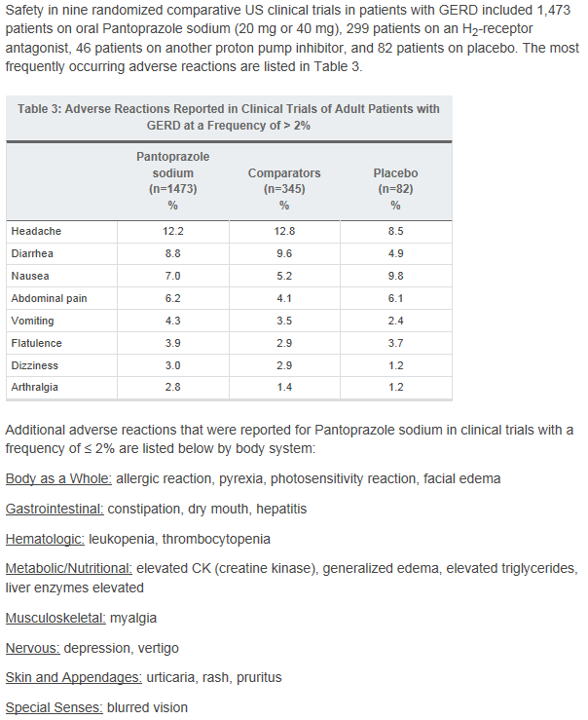
Adverse effects / side effects
Notes:
Pantoprazole package insert
http://www.drugs.com/pro/pantoprazole.html

Slide 34
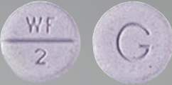
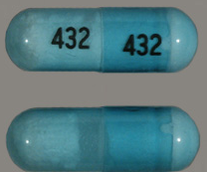
CYP Enzyme interactions
Inhibitory profiles of the five studied PPIs were similar
Lansoprazole and pantoprazole are the most potent in vitro inhibitors of CYP2C19 and CYP2C9, respectively.
Esomeprazole showed less inhibitory potency compared with omeprazole and its R-enantiomer.
The inhibitory potency of rabeprazole was relatively lower than the other PPI’s, but its thioether analog showed potent inhibition on the P450 enzymes investigated, which may be clinically significant.
WARFARIN SODIUM 2 MG TABLET
PHENYTOIN SOD EXT 300 MG CAP
Notes:
Xue-Qing Li, et. al. “Comparison of Inhibitory Effects of the Proton Pump-Inhibiting Drugs Omeprazole, Esomeprazole, Lansoprazole, Pantoprazole, and Rabeprazole on Human Cytochrome P450 Activiies.

Slide 35
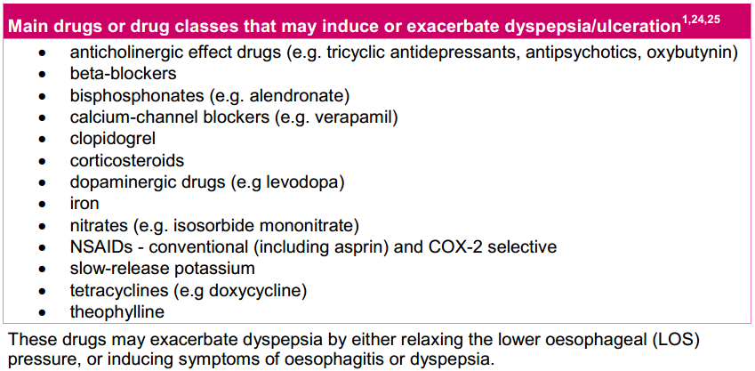
Other Drug-drug interactions
Notes:
http://www.nps.org.au/__data/assets/pdf_file/0012/111423/Clinical_guidance_final_PPI.pdf

Slide 36
PPI discontinuation & weaning
Unnecessary medications defined by the SOM are:
In excessive doses (including duplicate therapy)
For excessive duration
Without adequate monitoring
Without adequate indications for its use
In the presence of adverse consequences that indicate the dose should be reduced or discontinued
Notes:
Brandt,N.; Stefanacci, R. Discontinuation of Unnecessary Medications in Older Adults. Consult Pharm 2011;26:845-54.
State Operations Manual (SOM) defines the unnecessary medications commonly used in nursing facilities.
SOM is used and enforced by surveyors of nursing facilities.

Slide 37
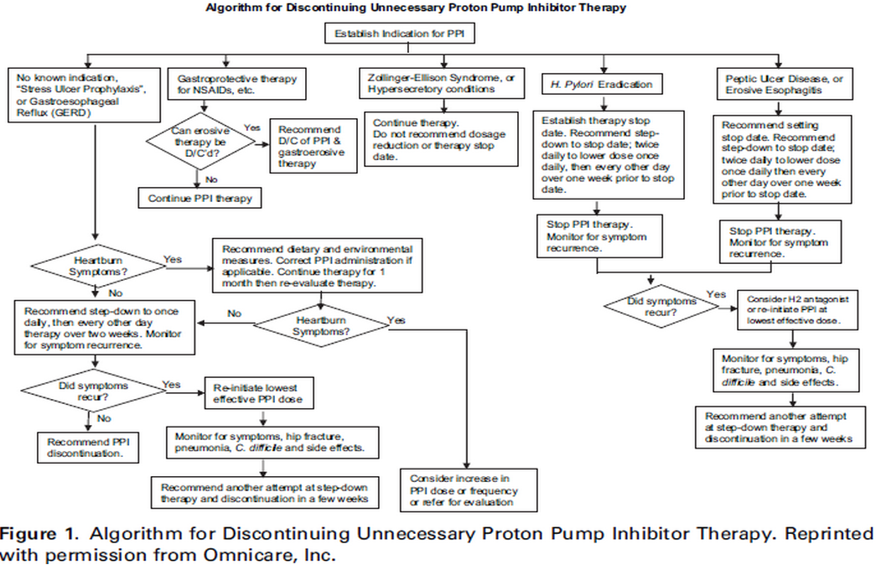
PPI discontinuation & weaning
Notes:
Discontinuing unnecessary medications is important not only from a regulatory and cost standpoint, but also because it decreases the risk of adverse drug reactions (ADRs). ADRs are intrinsic, as well as extrinsic, to the patient.

Slide 38
Refractory gerd
Between 10-40% of patients with GERD fail to respond symptomatically, either partially or completely, to a standard-dose PPI.
Diagnostic tests to identify residual reflux (acidic, nonacidic or bile), anatomical and histological include:
Upper gastrointestinal endoscopy
Esophageal biopsies for dilated intercellular spaces (DIS)
Ambulatory 24-H esophageal pH monitoring/wireless pH capsule (‘Bravo’)
Ambulatory 24-H esophageal impedance and pH monitoring.
Esophageal Bilitec.
Notes:
There was a doubling in the use of double-dose PPIs in patients between 1997-2004.
https://docs.google.com/file/d/0BxdPy_udLBt2OXpOM0tHWVVLeGM/edit

Slide 39
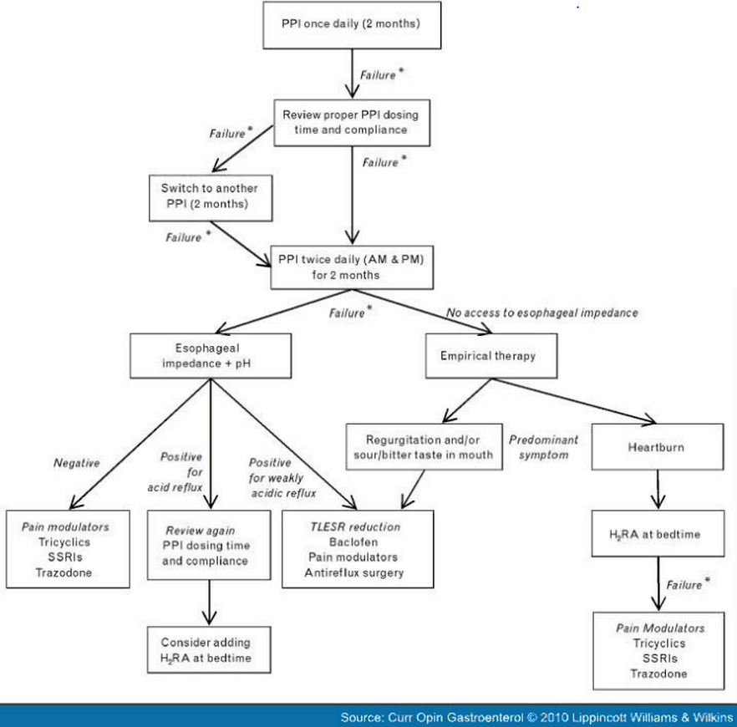
PPI discontinuation in the setting of refractory gerd
Notes:
https://docs.google.com/file/d/0BxdPy_udLBt2OXpOM0tHWVVLeGM/edit

Slide 40
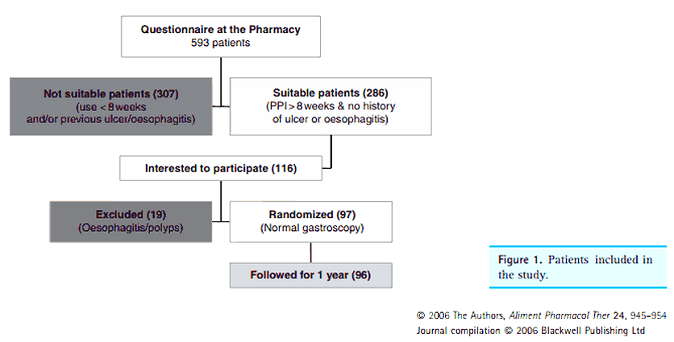
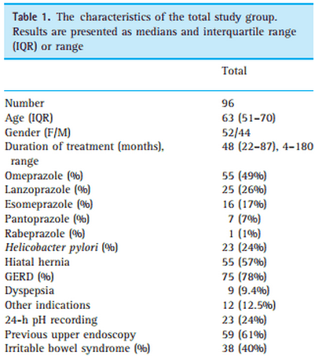
Weaning Study
“Discontinuation of proton pump inhibitors in patients on long-term therapy: a double-blind, placebo-controlled trial”
Notes:
https://docs.google.com/file/d/0BxdPy_udLBt2ZlRZZzVwcnYzUVU/edit

Slide 41
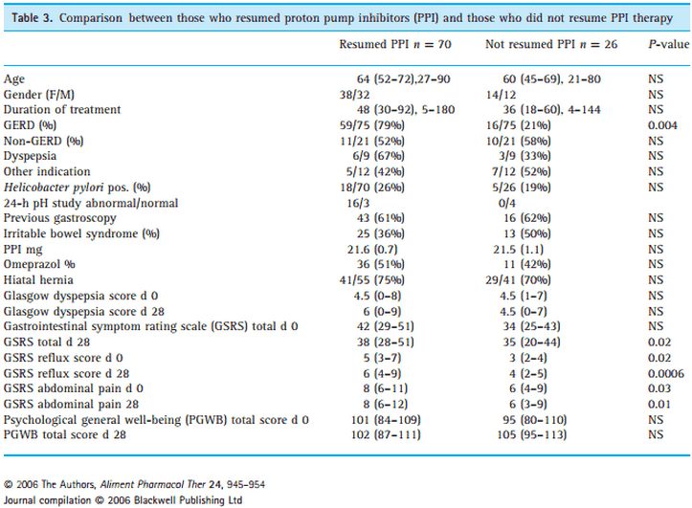
PPI discontinuation & weaning
Notes:
In conclusion, discontinuation of PPI was successful
in 27% of long-term PPI users. GERD patients had
more difﬁculty discontinuing PPI than non-GERD
patients. Hypergastrinaemia seems to be an important
predictor of PPI requirement in GERD patients. Discon-
tinuation of these drugs might be possible in some PPI
users without a strong indication for the drug, especi-
ally if they do not have symptoms of GERD, although
recommendations on the mode of discontinuation can
not be made at the present time.

Slide 42
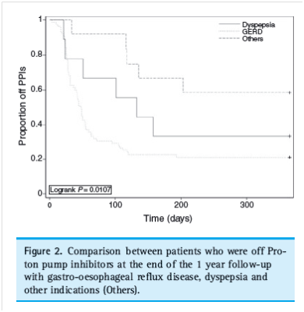
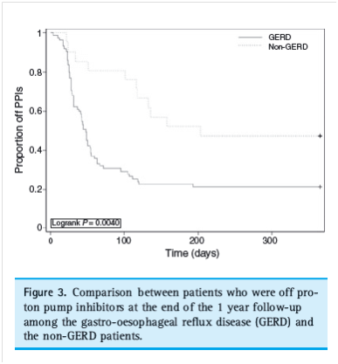
PPI discontinuation & weaning
Notes:
In conclusion, discontinuation of PPI was successful in 27% of long-term PPI users. GERD patients had
more difﬁculty discontinuing PPI than non-GERD patients. Hypergastrinaemia seems to be an important
predictor of PPI requirement in GERD patients. Discontinuation of these drugs might be possible in some PPI
users without a strong indication for the drug, especially if they do not have symptoms of GERD, although
recommendations on the mode of discontinuation can not be made at the present time.

Slide 43
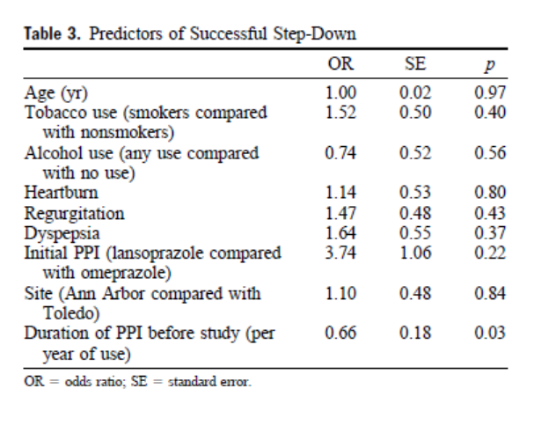
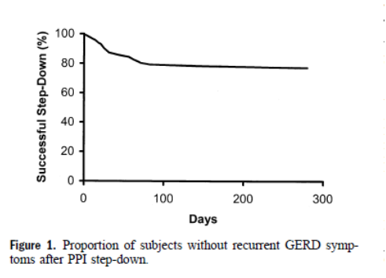
Ppi dosing step-down study
“Step-Down From Multiple- to Single-Dose Proton Pump Inhibitors: A Prospective Study of Patients with Heartburn or Acid Regurgitation Completely Relieved with PPIs”
Notes:
https://docs.google.com/file/d/0BxdPy_udLBt2WGF5S2ZjZ0tfSXc/edit

Slide 44
Summary points
Do not stop PPIs suddenly given that rebound activation of the PPI can occur
Gradual step-down:
Go from BID dosing to a lower single daily dose
Single daily doses should be reduced to doses every other day, to every third day for a few doses
Administer PPIs 30 to 60 minutes before the first meal of the day
PPI administration should precede the evening meal by 30 to 60 minutes if night time symptoms occur.
With proper administration, twice-daily or high-dose PPI therapy may be able to be reduced
Monitor for hip fracture, Pneumonia, C. difficile, Hypomagnesaemia, & Vitamin B12 deficiency
Monitor for adequate calcium and vitamin D intake to minimize the osteoporotic effects of PPIs

Slide 45

review
Introduction & Problem Statement
Controversy of PPI Rx use
Indications
FDA labeled indications
Off-label indications
Side Effects / Adverse Effects
Minor side effects
Major side effects
PPI Weaning
Step-down studies

Slide 46
Reference
1. Lew EA, Pisegna JR, Starr JA, et al. Intravenous pantoprazole rapidly controls gastric acid hypersecretion in patients with Zollinger-Ellison syndrome. Gastroenterology 2000;118:696-704.
2. Brunner G, Harke U. Long-term therapy with pantoprazole in patients with peptic ulceration resistant to extended high-dose ranitidine treatment. Aliment Pharmacol Ther 1994;8(S1):59-64.
3. Protonix (pantoprazole) package insert. Philadelphia, PA: Wyeth Laboratories; 2013 Dec.
4. van Zyl J, van Rensburg C, Vieweg W, et al. Efficacy and safety of pantoprazole versus ranitidine in the treatment of patients with symptomatic gastroesophageal reflux disease. Digestion 2004;70:61-9.
5. Meneghelli UG, Zaterka S, DePaula Castro L, et al. Pantoprazole versus ranitidine in the treatment of duodenal ulcer: a multicenter study in Brazil. Am J Gastroenterol 2000;95:62-66.
6. Katz PO, Gerson LB, Vela MF. Guidelines for the diagnosis and management of gastroesophageal reflux disease. Am J Gastroenterol 2013;108:308-28.
7. Chey WD, Wong BCY. American College of Gastroenterology guideline on the management of Helicobacter pylori infection. Am J Gastroenterol 2007;102:1808-25.
8. Richardson P, Hawkey CJ, Stack WA. Proton pump inhibitors. Drugs 1998;56:307-335.
9.Brunner G, Harke U. Long-term therapy with pantoprazole in patients with peptic ulceration resistant to extended high-dose ranitidine treatment. Aliment Pharmacol Ther 1994;8(S1):59-64.

Slide 47
Reference
10.Protonix I.V. (pantoprazole) package insert. Philadelphia, PA: Wyeth Pharmaceuticals Inc; 2012 Sep.
11. Prevacid (lansoprazole) package insert. Deerfield, IL: Takeda Pharmaceuticals America,Inc.; 2012 Aug.
12.Freston JW, Pilmer BL, Chiu YL, et al. Evaluation of the pharmacokinetics and pharmacodynamics of intravenous lansoprazole. Aliment Pharmacol Ther 2004;19:1111-22..
13. Nexium (esomeprazole) capsules, granules package insert. Wilmington, DE: AstraZeneca; 2014 Mar.
14. Richardson P, Hawkey CJ, Stack WA. Proton pump inhibitors. Drugs 1998;56:307-335.
15.Aciphex (rabeprazole) package insert. Woodcliff Lake, NJ: Eisai Inc.; 2013 Mar.
16. Talley NJ, Vakil N. Guidelines for the management of dyspepsia. Am J Gastroenterol 2005;100:2324-37.
17.Dellon ES, Gonsalves N, Hirano I, et al. ACG clinical guideline: Evidenced based approach to the diagnosis and management of esophageal eosinophilia and eosinophilic esophagitis (EoE). Am J Gastroenterol 2013;108:679-92.
18. Chey WD, Wong BCY. American College of Gastroenterology guideline on the management of Helicobacter pylori infection. Am J Gastroenterol 2007;102:1808-25.
19. DiCaro S, Zocco MA, Cremonini F, et al. Levofloxacin based regimens for the eradication of Helicobacter pylori. Eur J Gastroenterol Hepatol 2002;14:1309-1312.
20. Aciphex (rabeprazole) package insert. Woodcliff Lake, NJ: Eisai Inc.; 2013 Mar.

Slide 48
Reference
21. Nexium (esomeprazole) capsules, granules package insert. Wilmington, DE: AstraZeneca; 2014 Mar.
22. Malfertheiner P, Megraud F, O'Morain C, et al. Current concepts in the management of Helicobacter pylori infection: the Maastricht III Consensus Report. Gut 2007;56:772-81.
23.Laine L, Jensen DM. Management of patients with ulcer bleeding. Am J Gastroenterol 2012;107:345-60.
24.Nexium 24HR (esomeprazole) delayed-release capsules, package insert. Madison, NJ: Pfizer; 2014 Apr.
25. Xue-Qing Li, et. al. “Comparison of Inhibitory Effects of the Proton Pump-Inhibiting Drugs Omeprazole, Esomeprazole, Lansoprazole, Pantoprazole, and Rabeprazole on Human Cytochrome P450 Activiies.
26. Yu-Xiao Y., et. al. “Long-term Proton Pump Inhibitory Therapy and Risk of Hip Fracture.” JAMA. 2006;296:2947-2953
27.Bianchi Porro G, Lazzaroni M, Imbesi V, et al. Efficacy of pantoprazole in the prevention of peptic ulcers, induced by non-steroidal anti-inflammatory drugs: a prospective, placebo-controlled, double-blind, parallel group study. Dig Liver Dis 2000;32:201-8 28.Guillamondegui OD, Gunter OL, Bonadies JA, et al. Practice management guidelines for stress ulcer prophylaxis. EAST Practice Management Guidelines Committee. Accessed July 19, 2013. Available on the World Wide Web at http://www.east.org/tpg/stressulcer.pdf

Slide 49
Reference
28.Guillamondegui OD, Gunter OL, Bonadies JA, et al. Practice management guidelines for stress ulcer prophylaxis. EAST Practice Management Guidelines Committee. Accessed July 19, 2013. Available on the World Wide Web at http://www.east.org/tpg/stressulcer.pdf
29.Tsai WL, Poon SK, Yu HK, et al. Nasogastric lansoprazole is effective in suppressing gastric acid secretion in critically ill patients. Aliment Pharmacol Ther 2000;14:123-7.
30.Olsen KM, Devlin JW. Comparison of the enteral and intravenous lansoprazole pharmacodynamic responses in critically ill patients. Aliment Pharmacol Ther 2008;28:326-33.
31. Howden CW, Hunt RH. Guidelines for the management of Helicobacter pylori infection. Am J Gastroenterol 1998;93:2330-2308.
32. Prilosec (omeprazole) package insert. Wilmington, DE: AstraZeneca; 2014 Mar.
33. Phillips JO, Metzler MH, Palmieri TL, et al. A prospective study of simplified omeprazole suspension for the prophylaxis of stress-related mucosal damage. Crit Care Med 1996;24:1793-800.
34. Shakayta, MD and Saad R. Barrett’s Esophagus. American Academy of Family Physicians2004 692114-211
35.Martin LF, Booth FV, Reines HD, et al. Stress ulcers and organ failure in intubated patients in surgical intensive care units. Ann Surg 1992;215:332-337.

Slide 50
Reference
36.Prod'hom G, Leuenberger P, Koerfer J, et al. Nosocomial pneumonia in mechanically ventilated patients receiving antacid, ranitidine, or sucralfate as prophylaxis for stress ulcer. A randomized controlled trial. Ann Intern Med 1994;120:653-662.
37. Lanza FL.Guideline for the Treatment and Prevention of NSAID-Induced Ulcers THE AMERICAN JOURNAL OF GASTROENTEROLOGY Vol. 93, No. 11, 1998
38.Guillamondegui OD, Gunter OL, Bonadies JA, et al. Practice management guidelines for stress ulcer prophylaxis. EAST Practice Management Guidelines Committee. Accessed July 19, 2013. Available on the World Wide Web at http://www.east.org/tpg/stressulcer.pdf

